Slide 1
Easy Answers for Every Business Decision
The Market Research Event
OCTOBER 18, 2016

Slide 2
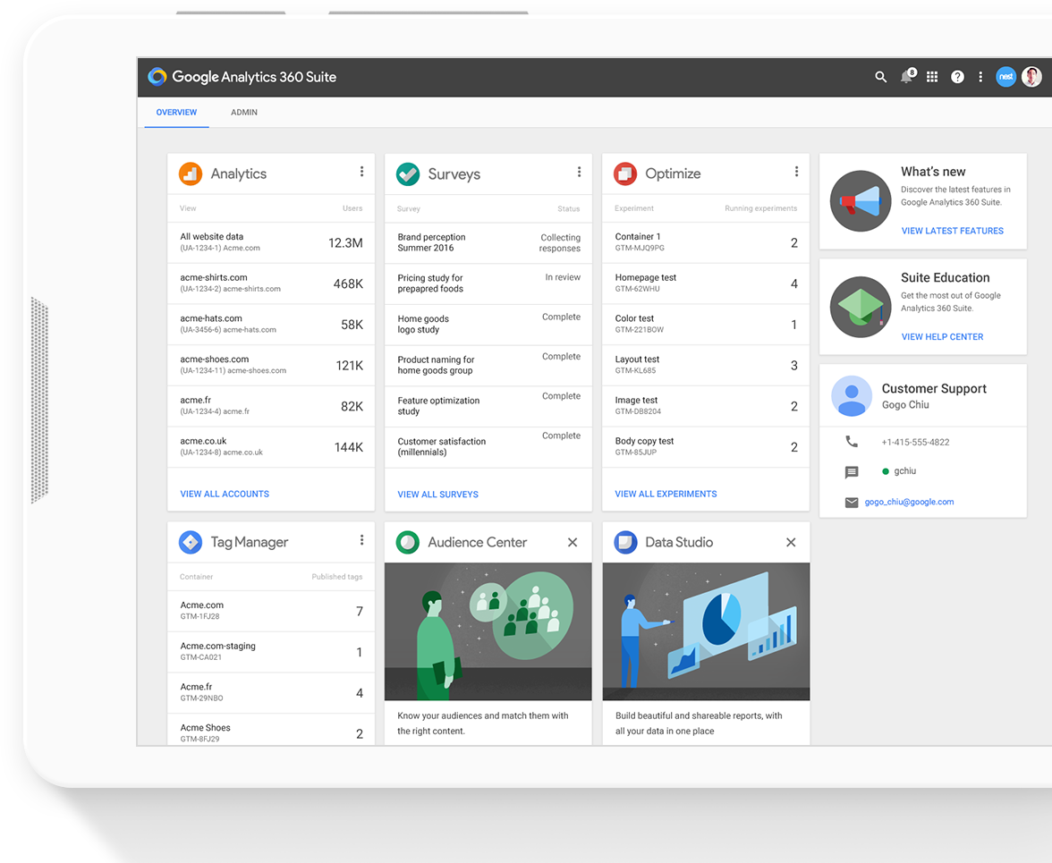
The Google Analytics 360 Suite
The Google Analytics 360 Suite offers a powerful and integrated analytics solution for today’s biggest enterprises. Measure and improve the impact of your marketing across every screen, channel and moment in today’s customer journey. It’s easy to use, makes data accessible for everyone, and helps you discover and use the “ahas” you need to win.

Slide 3
The Google Analytics 360 Suite
Data Studio 360 Data Analysis and Visualization
Analytics 360
Customer Insights
Attribution 360
Marketing
Measurement
Optimize 360
Site Testing & Personalization
Audience Center 360
Audience Management
Tag Manager 360 Data Collection

Slide 4
Introducing...

Slide 6
Starting Tomorrow
Data Studio 360 Data Analysis and Visualization
Analytics 360
Customer Insights
Attribution 360
Marketing
Measurement
Optimize 360
Site Testing & Personalization
Audience Center 360
Audience Management
Surveys 360
Research & Insights
Tag Manager 360 Data Collection

Slide 7
Google Surveys 360 will bring the
Customer Voice
to the Google Analytics 360 Suite.
Notes:
The suite today make it easy to get a clearer picture of not just what your customers are buying, where they're going, and how they're purchasing. With the additon of Surveys we now also get a clear picture of why they're doing it

Slide 8
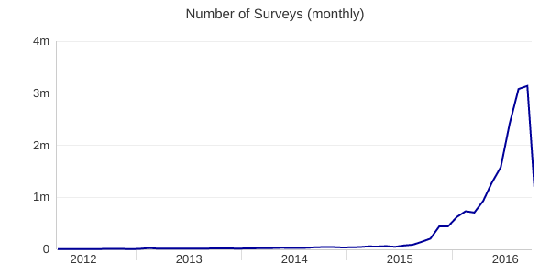
The Evolution of Google Consumer Surveys
2012
2016
Launched in 2012, Google Consumer Surveys provides users a better, faster way to survey a representative sample of their target population across the web and on mobile devices.
We’re now serving nearly 1M surveys a week to respondents on our web and mobile panels

Slide 9
Over 10M+ available respondents
Millions of respondents complete surveys on partner publisher sites
Over 5M+ downloads on mobile app, Google Opinion Rewards
Unique sample source of real, everyday people
Demographics provided (inferred on web and declared on app), tapping into Google’s advertising technology

Slide 10
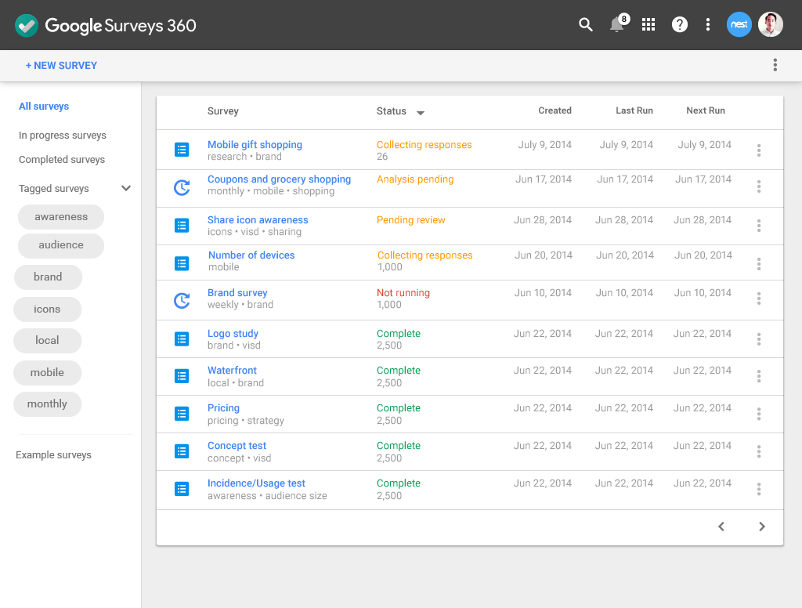
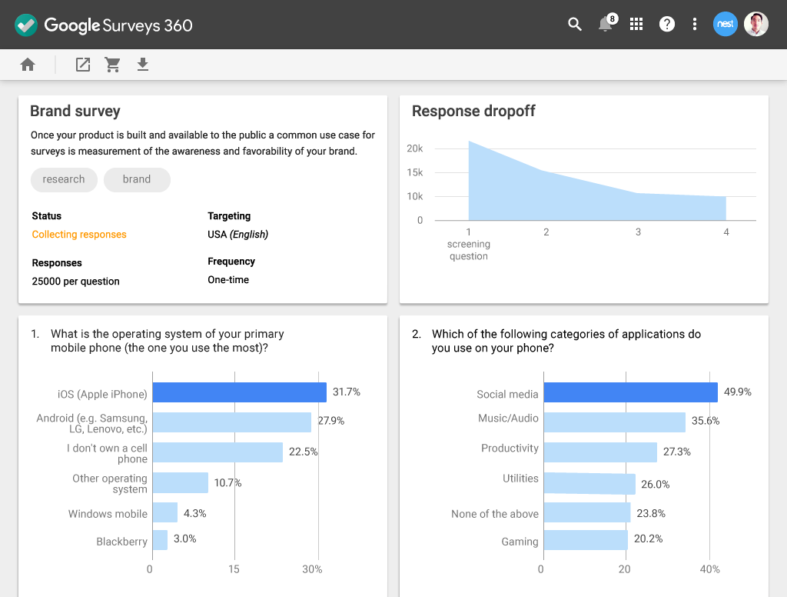
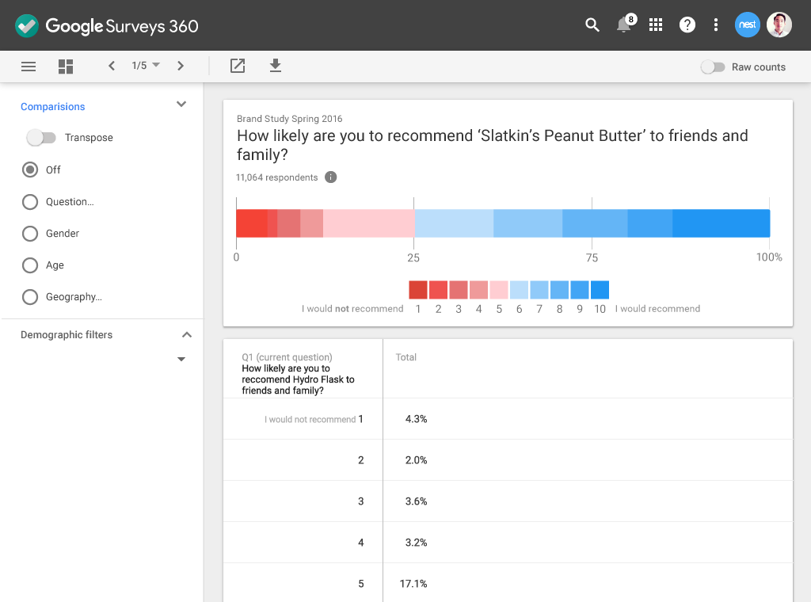
Google Surveys & Google Surveys 360 user interface was rebuilt from the ground up to be simple and easy to use, with new interactive crosstabs.

Slide 14
 | Google Surveys | Google Surveys 360
User List Targeting
Zip Code Targeting
Occupation & Industry Targeting
Custom Panels
API Access | Online Support | Enterprise Level Service
Administration | Basic | Advanced
Services and Support | Online Help Center, Email, and Phone | Enterprise Level Service
Payment Options | Credit Card | Invoiced Monthly
Pricing Starting at | $50/survey | $3,000/month
Google Surveys, a pay-as-you-go solution, will still be available for those who don’t need advanced features and support.

Slide 15
Core Use Cases
Consumer Research
Ad Effectiveness Measurement
Brand Tracking
Take a pulse on consumer demands, behaviors and preferences
Get answers to tactical business questions
Make timely decisions with fast, accurate and actionable consumer data
Reach the right people at the right time through the power of User List targeting
Gain deeper insight into the 'why' and 'how' to complement campaign metrics
Measure campaign awareness and recall
Keep a regular pulse on brand awareness, perception or purchase intent
Identify leading indicators of shifting perception
Measure the impact of current events or buzz

Slide 16
YouVisit
Consumer Research
Research with Google Surveys
YouVisit understood how powerful their technology was and knew that more people were trying virtual reality. In order to provide significant data on this, they needed to understand the marketplace.
What They Did
They were able to run surveys across a statistically significant sample set which gathered data on the consumer awareness of virtual reality.
Outcome
From this data, they were able to make decisions about the future of their business by understanding what users were looking for in an immersive experience.

Slide 17
BuzzFeed
Ad Effectiveness Measurement
Research with Surveys 360
BuzzFeed launched their unique advertising strategy by placing products in their fun, interactive videos.
What They Did
They needed to understand how effective their ads were with the audiences that were viewing them.
Outcome
Through Google Surveys 360, they were able to target the audiences who had seen their ads and understand the effectiveness of their strategy, as well as share the results with their clients.

Slide 18
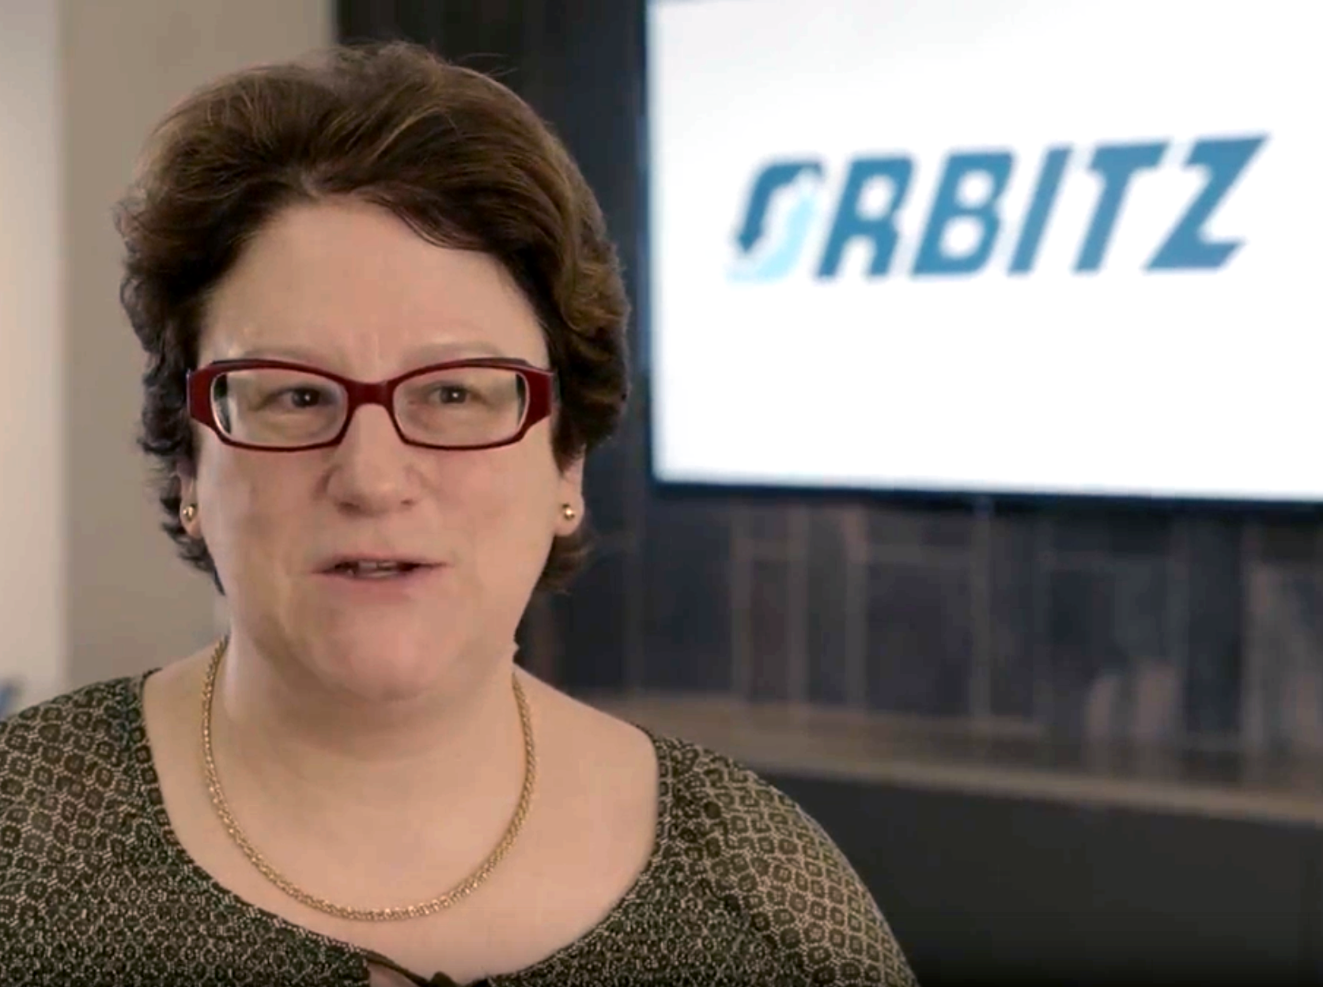
Orbitz
Brand Tracking
Research with Surveys 360
Orbitz had a significant brand tracking campaign planned for 2016 to track how consumers are booking travel online.
What They Did
Orbitz used Google Surveys 360 Brand Tracker functionality to target respondents who had booked online travel in the past year.
Outcome
Orbitz is now able to follow and track their brand against competitors to understand how they fit into the market and how awareness and more importantly, intent is changing over time.

Slide 19
Example of how products in the Google Analytics 360 Suite work together for bigger and better insights.

Slide 20
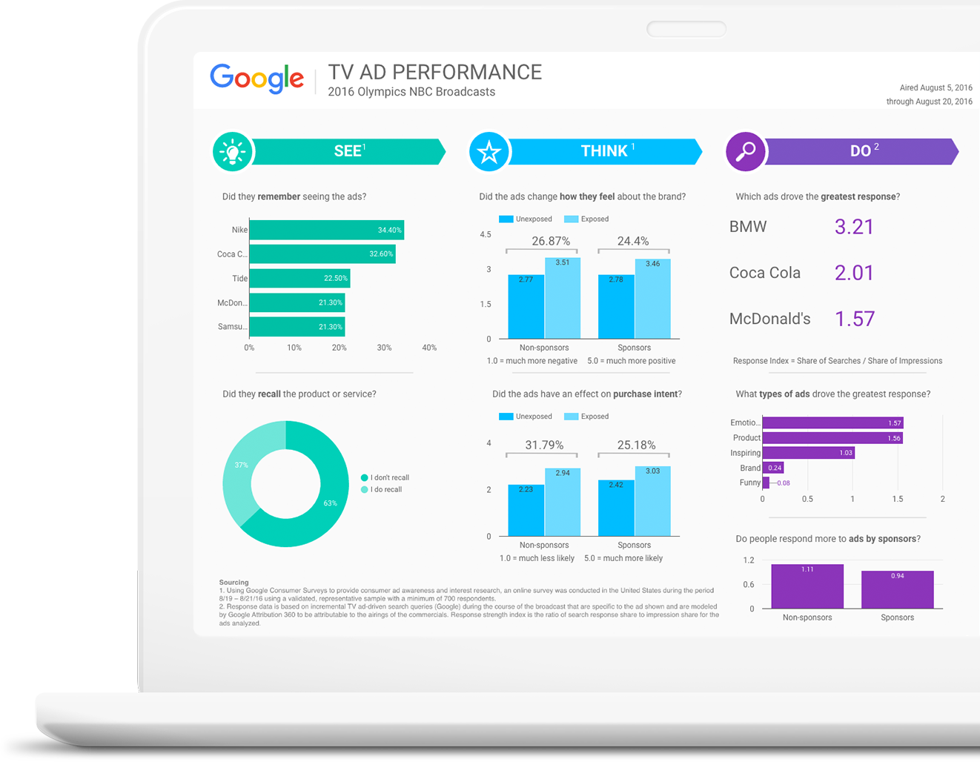
Rio 2016 Olympics
Using Google Surveys 360 and Google Attribution 360 together, we were able to quickly answer questions around TV ad performance during the Rio 2016 Olympics.
We then displayed this data using Google Data Studio (beta).

Slide 21
What costume would you most like to dress your pet as for Halloween?
Pikachu
Raptor
Taco
25%
33%
42%

Slide 22
Thanks for the continued partnership

